Slide 1


AICTE CHHATRA VISHWAKARMA AWARDS 2020
B.L.D.E.A’S V.P. DR P.G.HALAKATTI COLLEGE OF ENGG.
AND TECH. BIJAPUR – 03 affiliated TO
VISVESVARAYA TECHNOLOGICAL UNIVERSITY ,Belgaum
“smart Air and sound monitoring’’
APPLICATION NO. :
SUB CATEGORY : GREEN ENTREPRENEURSHIP
TEAM NAME :
INSTITUTION STATE : KARNATAKA
REGION : SOUTH - WEST
MENTOR : DR. PREMA T. AKKASALIGAR
TEAM MEMBERS :
AYUSH NAIK
BASAVARAJ S MUTTAGI
SHRIHARI KULKARNI
SOURAV KALAL

Slide 2
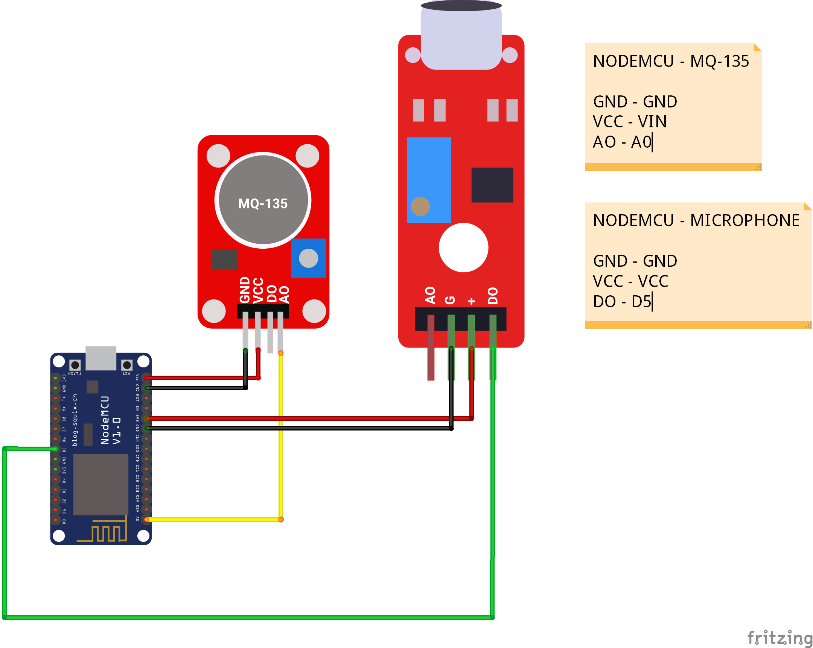
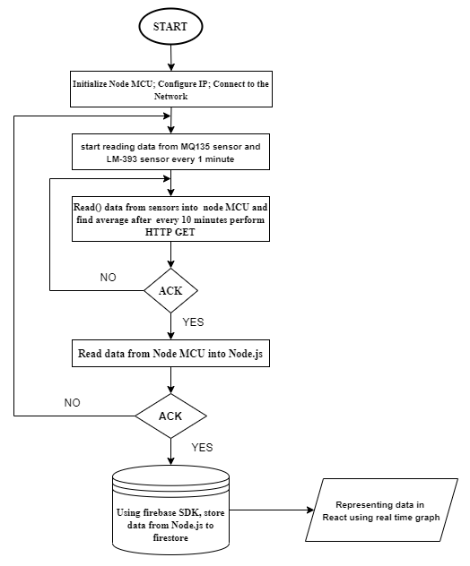
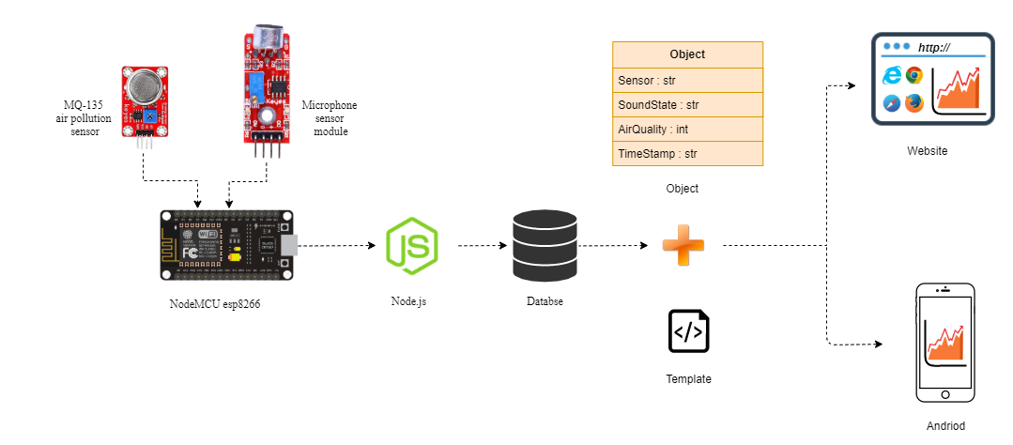
IMPLEMENTED PILOT PROJECT :
Flowchart
Circuit diagram
Figure 2: Circuit diagram
Implementation
Figure 1: Flow chart
Figure 3 : Implementation

Slide 3
This is for prototype

Slide 4
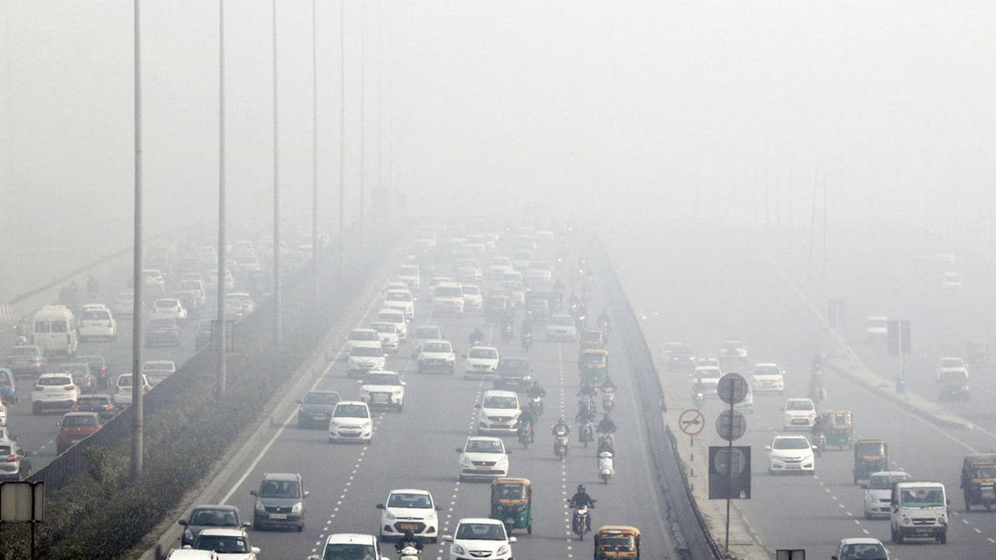

impact of proposed solution:
Air pollution refers to the release of pollutants into the air that is detrimental to human health and the planet as a whole.
Long-term health effects from air pollution include heart disease, lung cancer, and respiratory diseases such as emphysema. Air pollution can also cause long-term damage to people's nerves, brain, kidneys, liver, and other organs.
Therefore it is necessary to identify the air quality. This proposed project is implemented in various places in Vijayapura to measure air quality. This measured data will be helpful in identifying the air polluted areas and in spreading awareness about air pollution so that the people will become more responsible and avoid polluting the air. This data can also be sent to the Government to implement the ideas to prevent Air Pollution.

Slide 5
Literature Survey
No | Authors ,year, paper title | Description
1 | Lalit Mohan Joshi -2020 “Research paper on IOT based Air and Sound Pollution Monitoring System” | In this paper, the author used Gas Sensor (MQ135), CO Gas Sensor (MQ7), Smoke Sensor (MQ2), Temperature Sensor (DHT11) from which data is being collected and processed. Then it will be sent to the End users. Here we can get the content of all gases present in the air. A mic is used to sense the sound which is then amplified using a PM538 amplifier and the noise is measured. Advantages: The sensed data is stored in the spreadsheet and will show a trend of the sensed parameters with respect to the specified values. Here we used Firestore database to store data and present the live data to both website and mobile app.
2 | Kadri Abdullah, Yaacoub E., Mushtaha M., Abu-Dayya Adnan 2013 “Air Quality Monitoring and Analysis in Qatar using a Wireless Sensor Network Deployment” | This paper presents an ambient real-time air quality monitoring system. The system consists of several distributed monitoring stations that communicate wirelessly with a backend server using machine-to-machine communication. Each station is equipped with gaseous and meteorological sensors as well as data logging and wireless communication capabilities. The backend server collects real-time data from the stations and converts it into information delivered to users through web portals and mobile applications. The system is implemented in a pilot phase and four solar-powered stations are deployed over an area of 1 km. Data over four months has been collected. Performance analysis and assessment are performed. Advantages: Deployment is very difficult and implementation costs a lot. Our proposed project is “cost-effective” and deployment is very simple.

Slide 6
No | Authors, year, paper title | Description
3 | Okokpujie Kennedy, Noma-Osaghae Etinosa, Odusami Modupe, John Samuel, Oluwatosin Oluga -2018 “A Smart Air Pollution Monitoring System” | This project proposes an air pollution monitoring system. The system was developed using the Arduino microcontroller. The air pollution monitoring system was designed to monitor and analyze air quality in real-time and log data to a remote server, keeping the data updated over the internet. Air quality measurements were taken based on Parts per Million (PPM) metrics and analyzed using Microsoft Excel. The air quality measurements taken by the designed system was accurate. The result was displayed on the designed hardware's display interface and could be accessed via the cloud on any smart mobile device. Advantages: They used Microsoft Excel for analyzing data. Here in our project we prepared an entire back-end system by ourselves and provided an option for saving the data with a graph.
4 | F N Setiawan , I Kustiawan -2018 “IoT based Air Quality Monitoring” | This research is proposed to design an air quality monitoring system by utilizing the ESP8266 module. As a result, users can monitor the air quality using a smartphone connected through the ESP8266 Wi-Fi module. Therefore the condition of air is monitored every time. Thinkspeak is used as media to read the results from NodeMCU. Advantages: Authors send data to smartphone devices only. In our project, the data is sent to both the website and smartphone. The advantages of sending data to the website are that anyone with a URL can visit and check the air and sound monitoring.

Slide 7

IMPLEMENTATION AND OUTREACH PLAN:
Requirements:
MQ-135 sensor
Microphone sensor module
NodeMCU ESP8266
Solar panels
Battery
The implementation of this project is very simple. We used the MQ-135 air quality sensor which measures the air quality in ppm and a microphone sensor module measures the air quality then the measured data is sent to the NodeMCU ESP8266 Wi-fi module. This data is next transferred to the Node.js server from here the data is sent to the Firebase server from which the data is converted into a simple graph for better understanding and also the data is sent to the android app.

Slide 8
Financial implication
ITEMS | QUANTITY | PRICE(In Rs.)
MQ-135 Sensor | 1 | 120
Solar Panel 6V 0.8W | 1 | 90
Battery 9V | 1 | 25
NodeMCU ESP8266 | 1 | 400
Microphone Sound Sensor Module | 1 | 60
 | TOTAL | 695/-
The implemented project is cost-effective compared to the referenced projects. This project can be easily implemented on the college campus or in the government infrastructure building to identify the pollution in the building. And control air pollution by spreading awareness about it or taking precautions to avoid air pollution.

Slide 9
CONCLUSION
The proposed project includes the MQ-135 sensor and a microphone sensor module that measures the air quality and sound quality. This measured data is sent to the server. And displayed on the website as well as in the android app. Each data is updated every 10 minutes. This data can be stored in different formats as the end-users want. Also, anybody can check the air quality just by using a URL. There is no need for authentication. This project is cost-effective. As we used only the necessary sensors that help measure the air quality.

Slide 10

References
[1] Lalit Mohan Joshi “Research paper on IOT based Air and Sound Pollution Monitoring System” International Journal of Computer Applications (0975 – 8887) Volume 178 – No.7, November 2017
[2] Elias Yaacoub, Abdullah Kadri, Mohammed Mushtaha, and Adnan Abu-Dayya ““Air Quality Monitoring and Analysis in Qatar using Wireless Sensor Network Deployment”, Qatar Mobility Innovations Center (QMIC), Qatar Science and Technology Park, Doha, Qatar.
[3]Okokpujie Kennedy, Noma-Osaghae Etinosa, Odusami Modupe,John Samuel, Oluwatosin Oluga “A Smart Air Pollution Monitoring System” International Journal of Civil Engineering and Technology (IJCIET)Volume 9, Issue 9, September 2018,
[4] N Setiawan and I Kustiawan “IoT based Air Quality Monitoring” Department of Electrical Engineering Education, Universitas Pendidikan Indonesia, No. 207, Bandung 40154, Indonesia
THANK YOU

